Slide 1


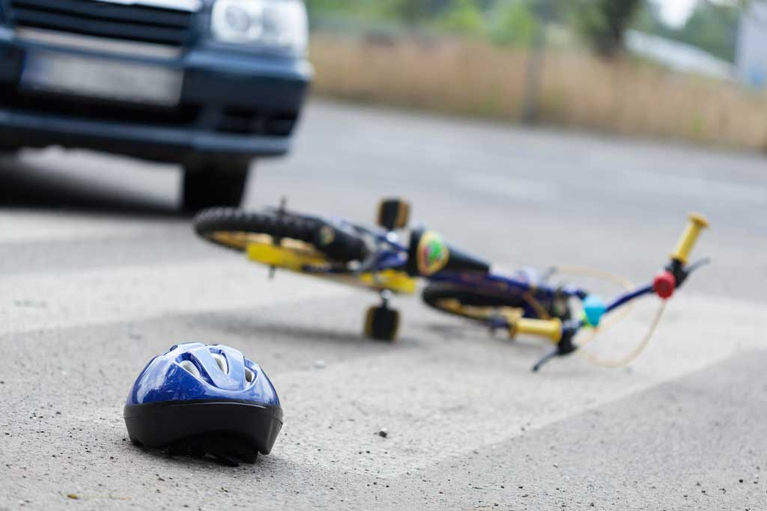
Bicycle Collisions in Philadelphia County:
Analysis & Recommendations
Gifty A. Arthur

Slide 2

Motivation
Why focus on bicycle accidents?

Slide 3
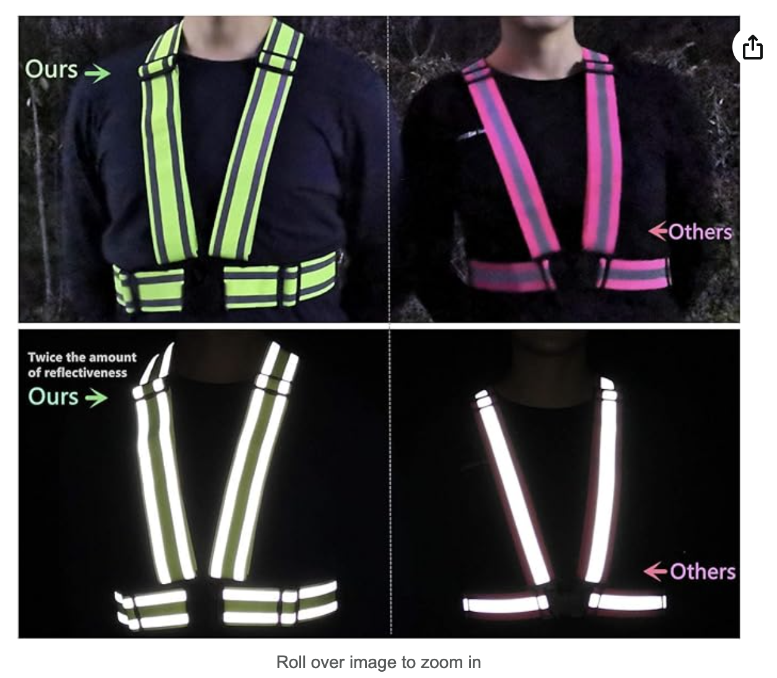
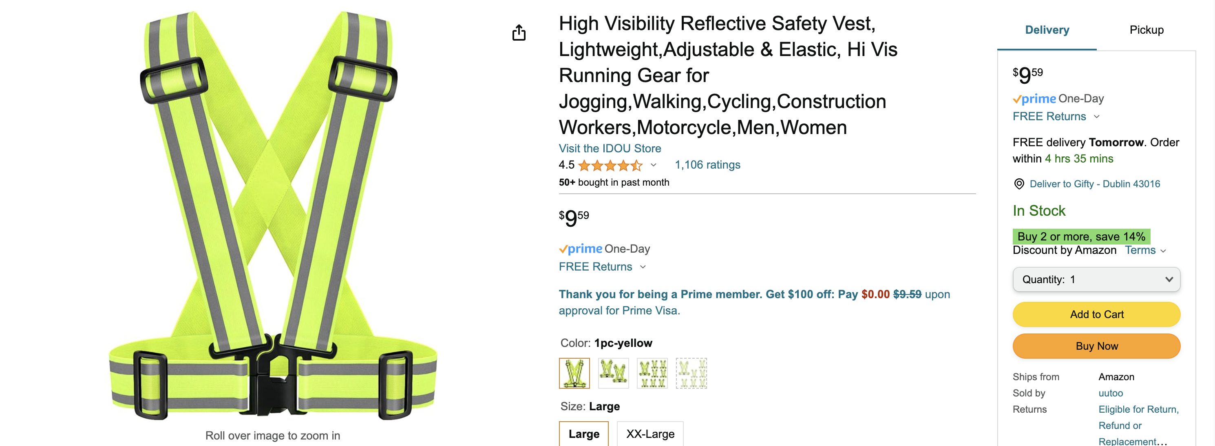
Link to Amazon:

Slide 4


Presentation Outline
Data Overview & Cycling Safety Initiatives
Visuals & Analysis: Insights from the Data
Bike Laws from Pennsylvania Vehicle Code
Insurance & Compensation: Navigating Legal Matters
Recommendations for Safer Cycling

Slide 5


Slide 6
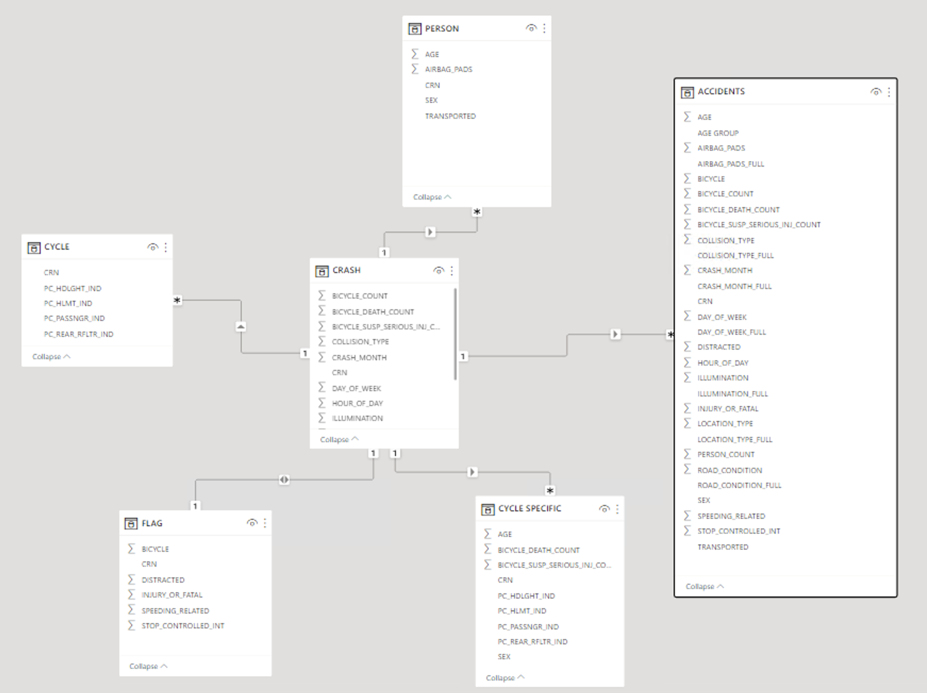

Slide 7

Visuals & Analysis
Crash Incidents for Philadelphia County for the year 2022.

Slide 8
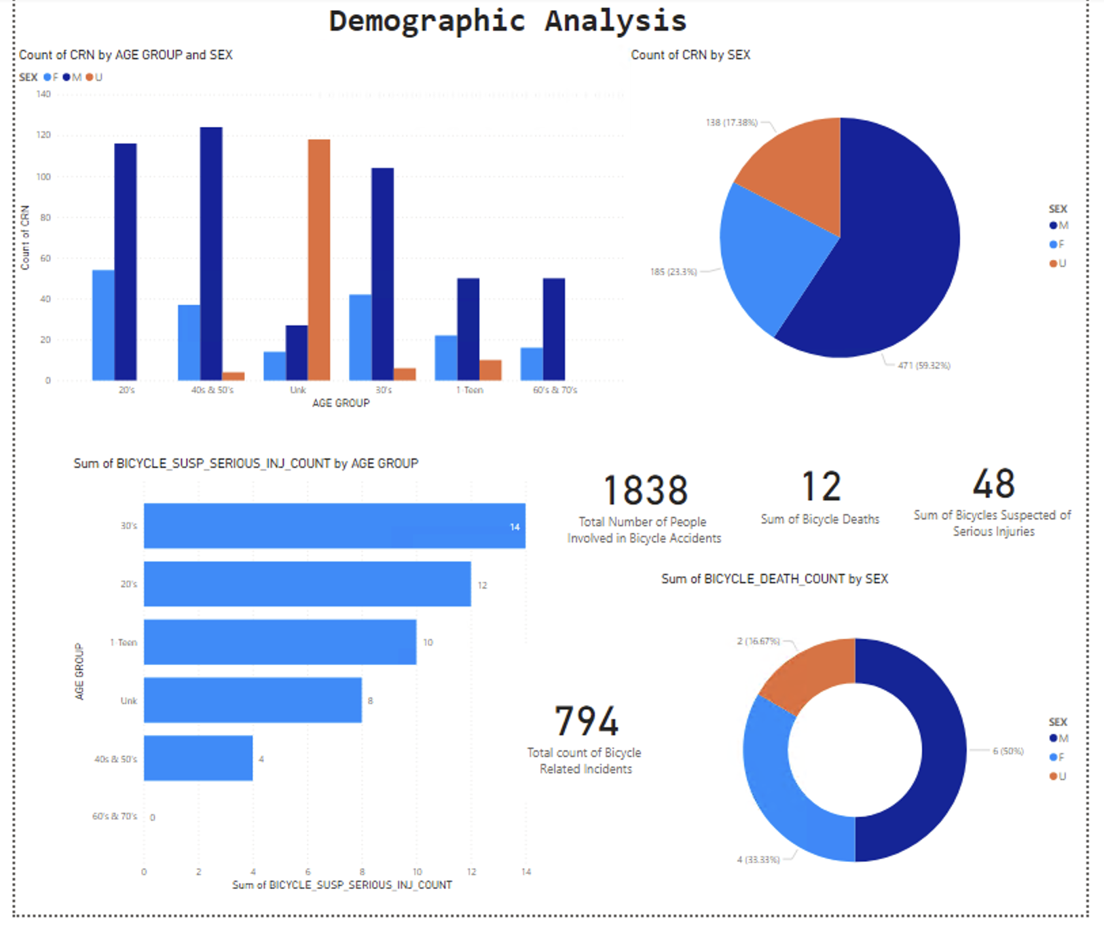

Slide 9
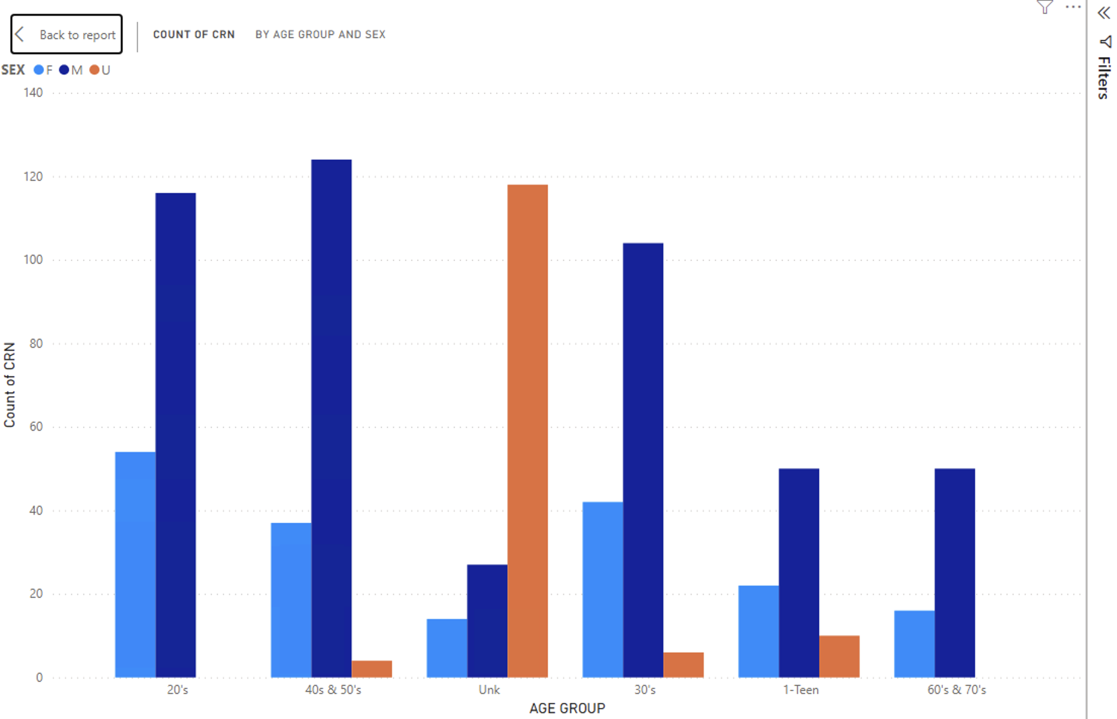

Slide 10
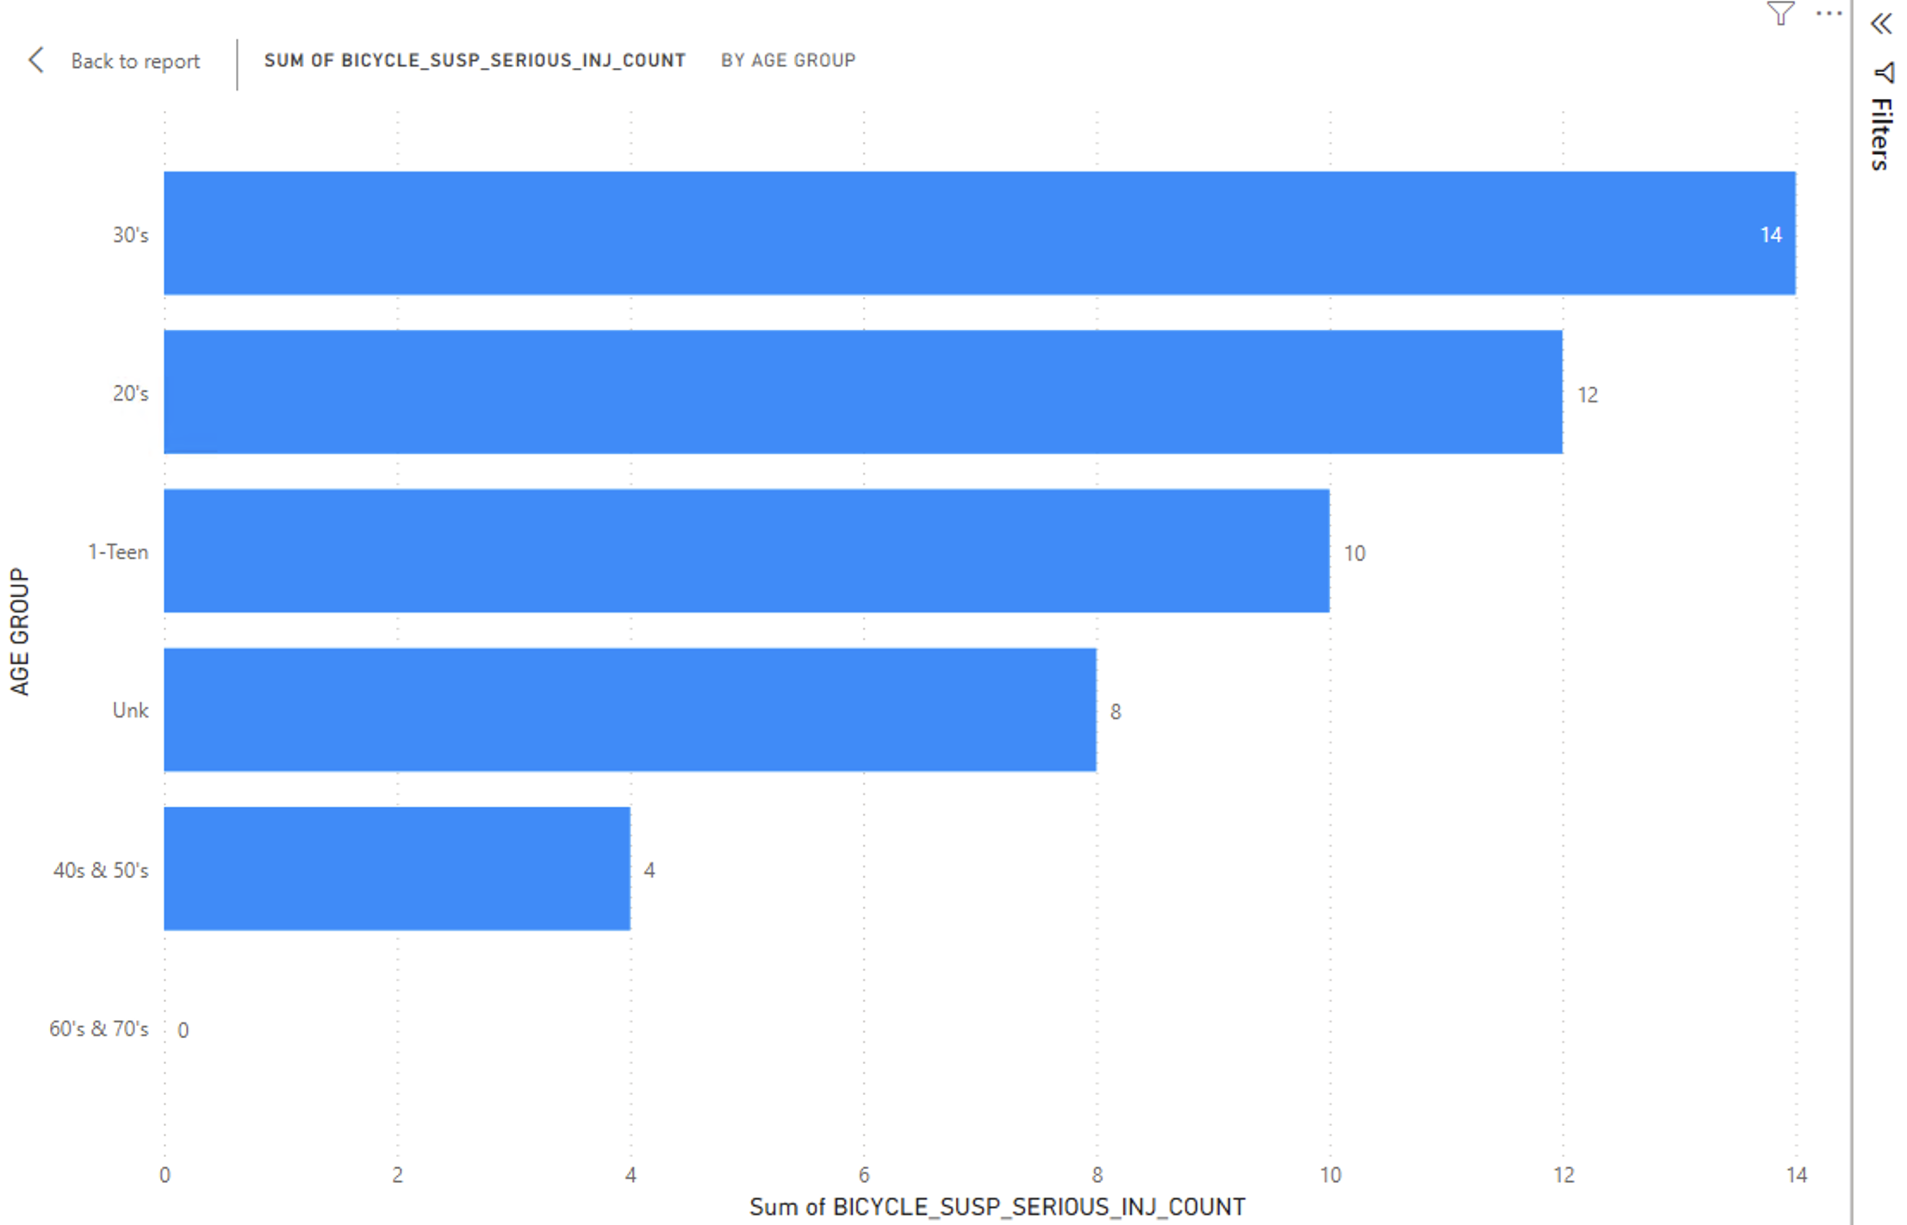

Slide 11
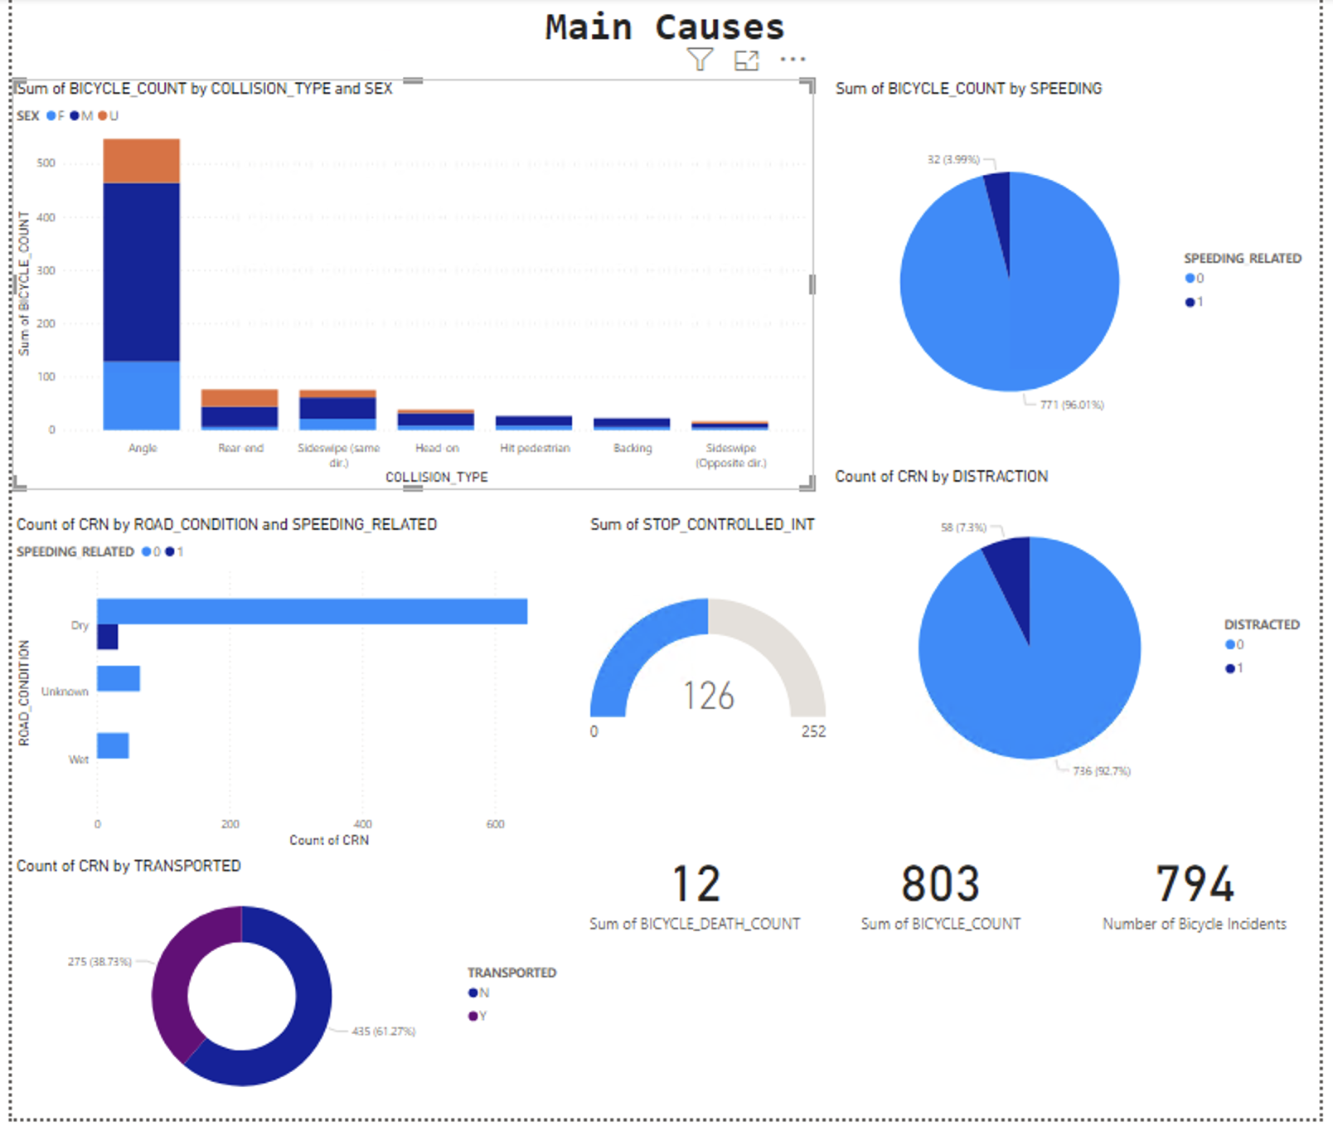

Slide 12
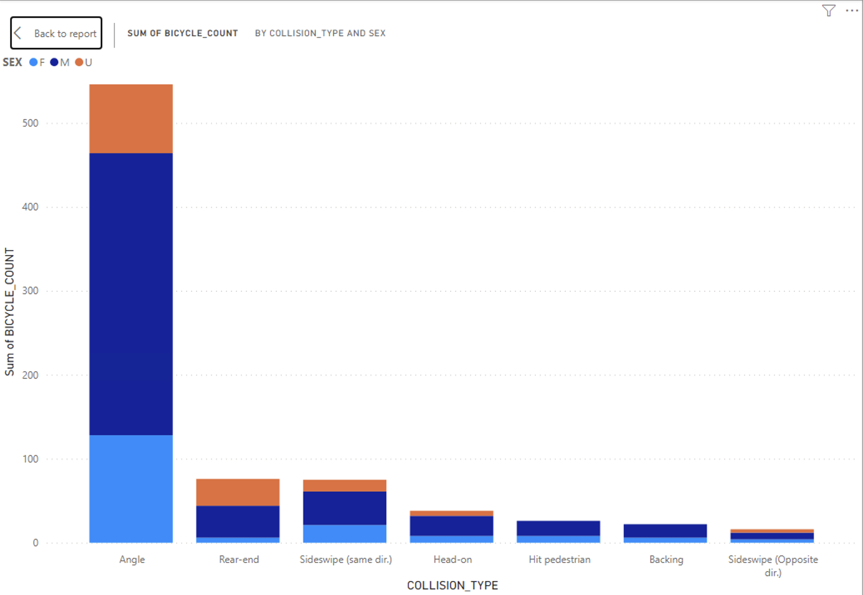

Slide 13
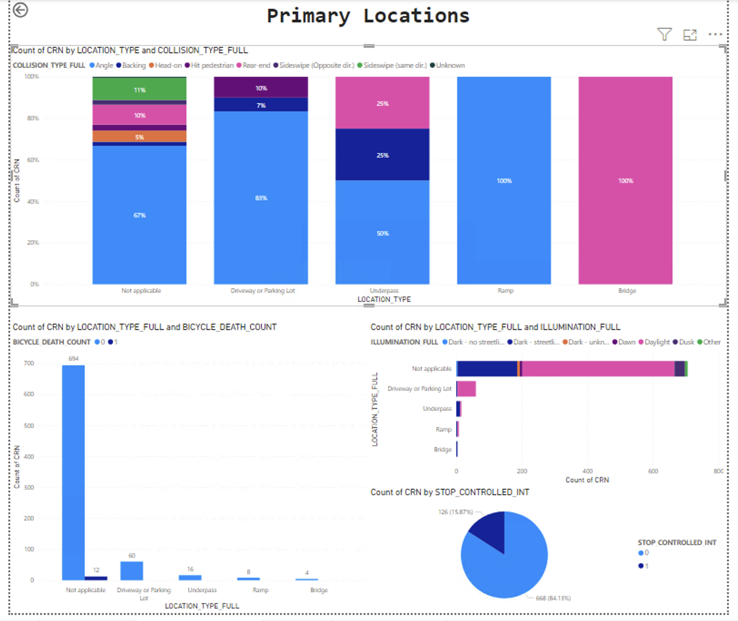

Slide 14
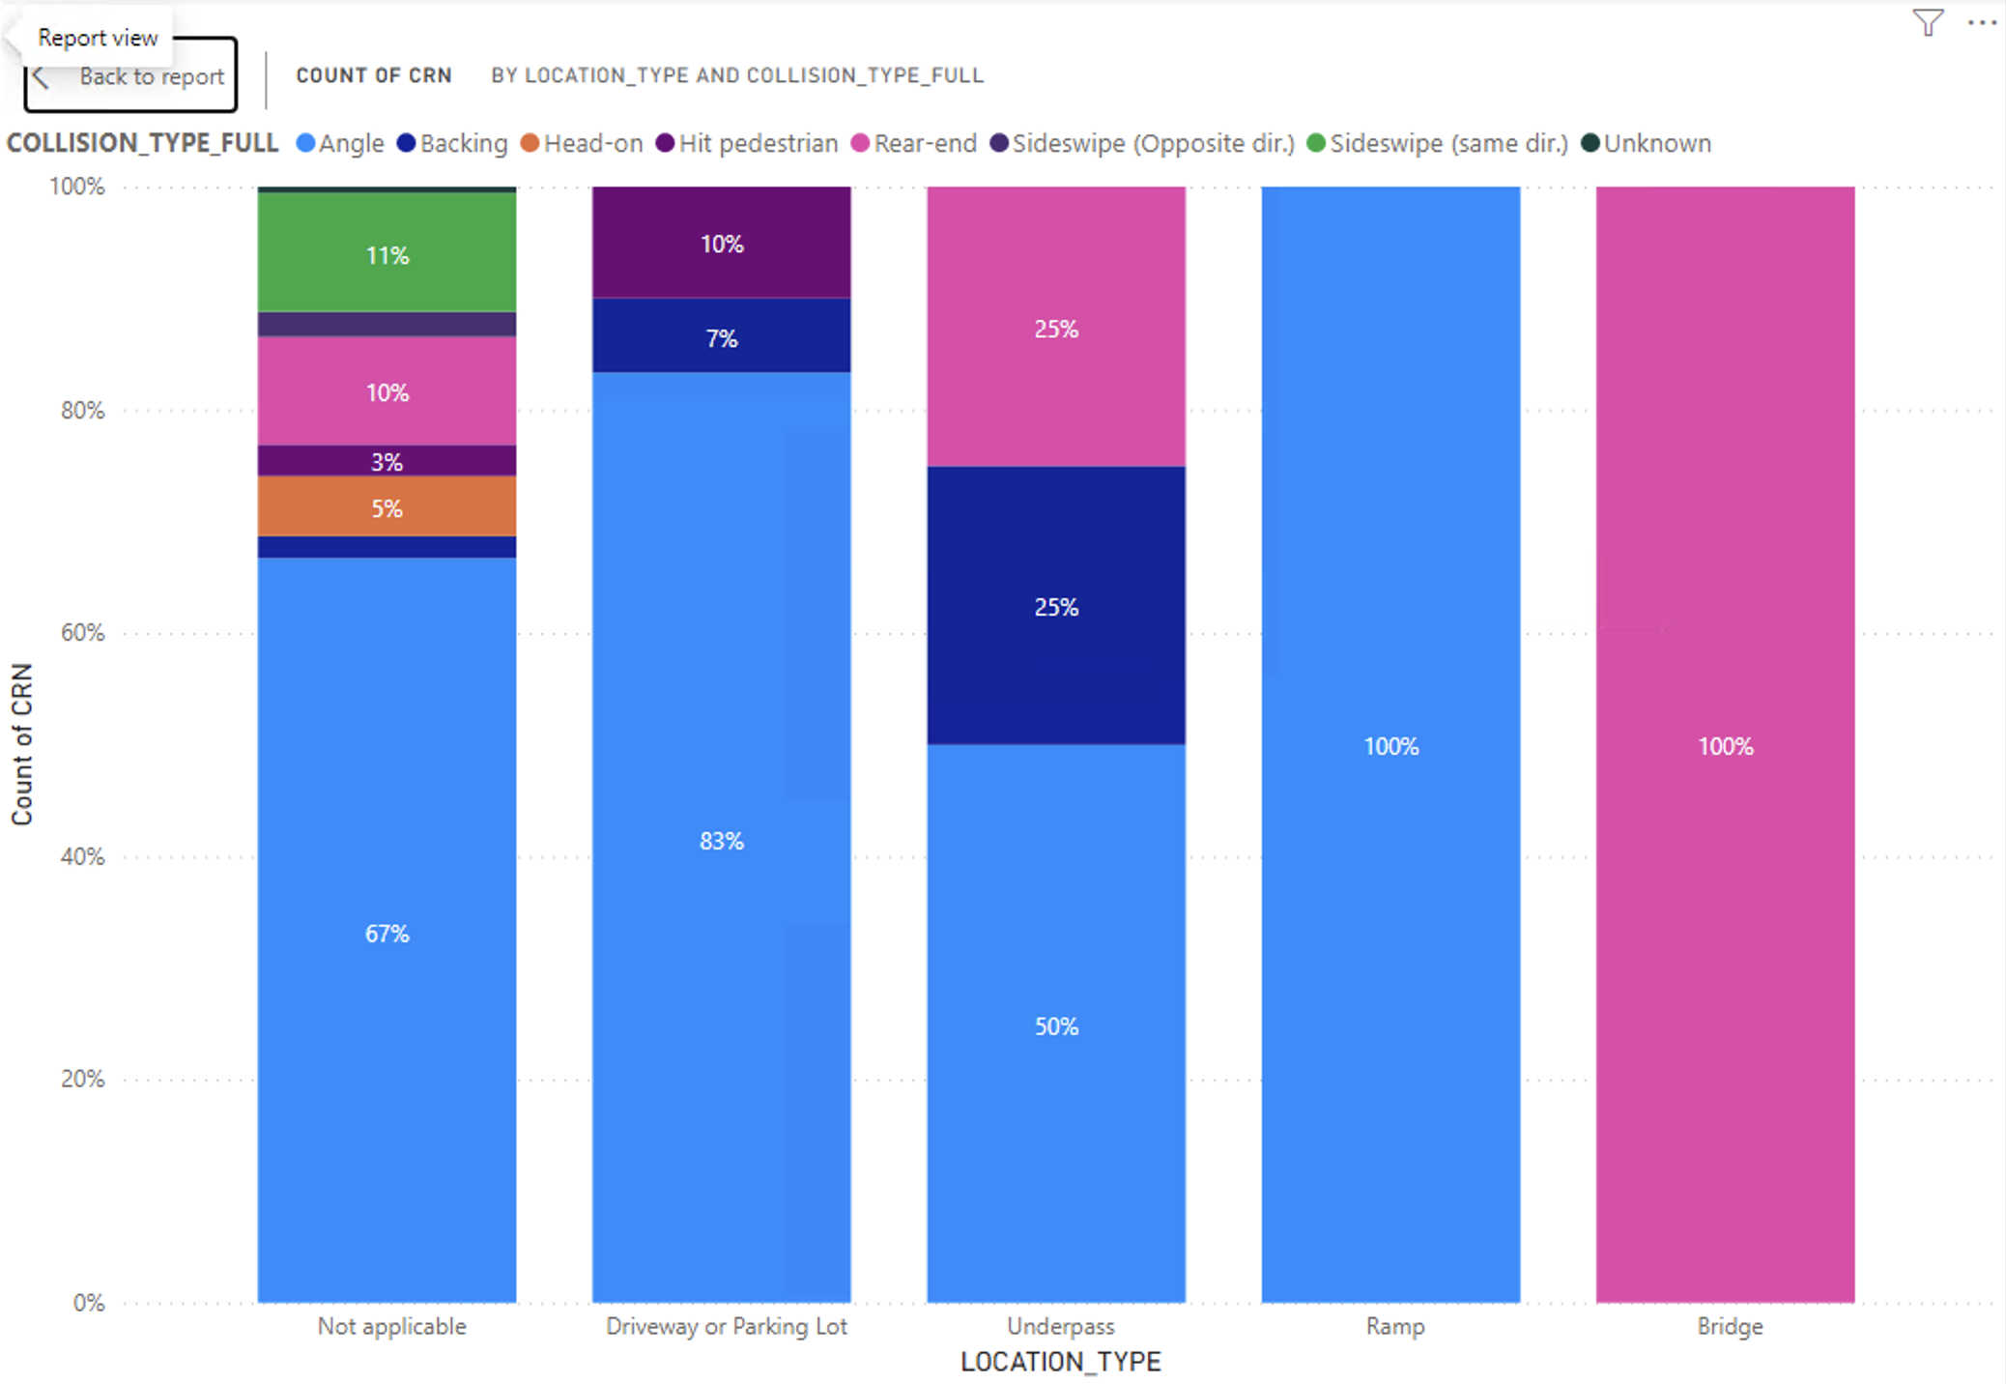

Slide 15
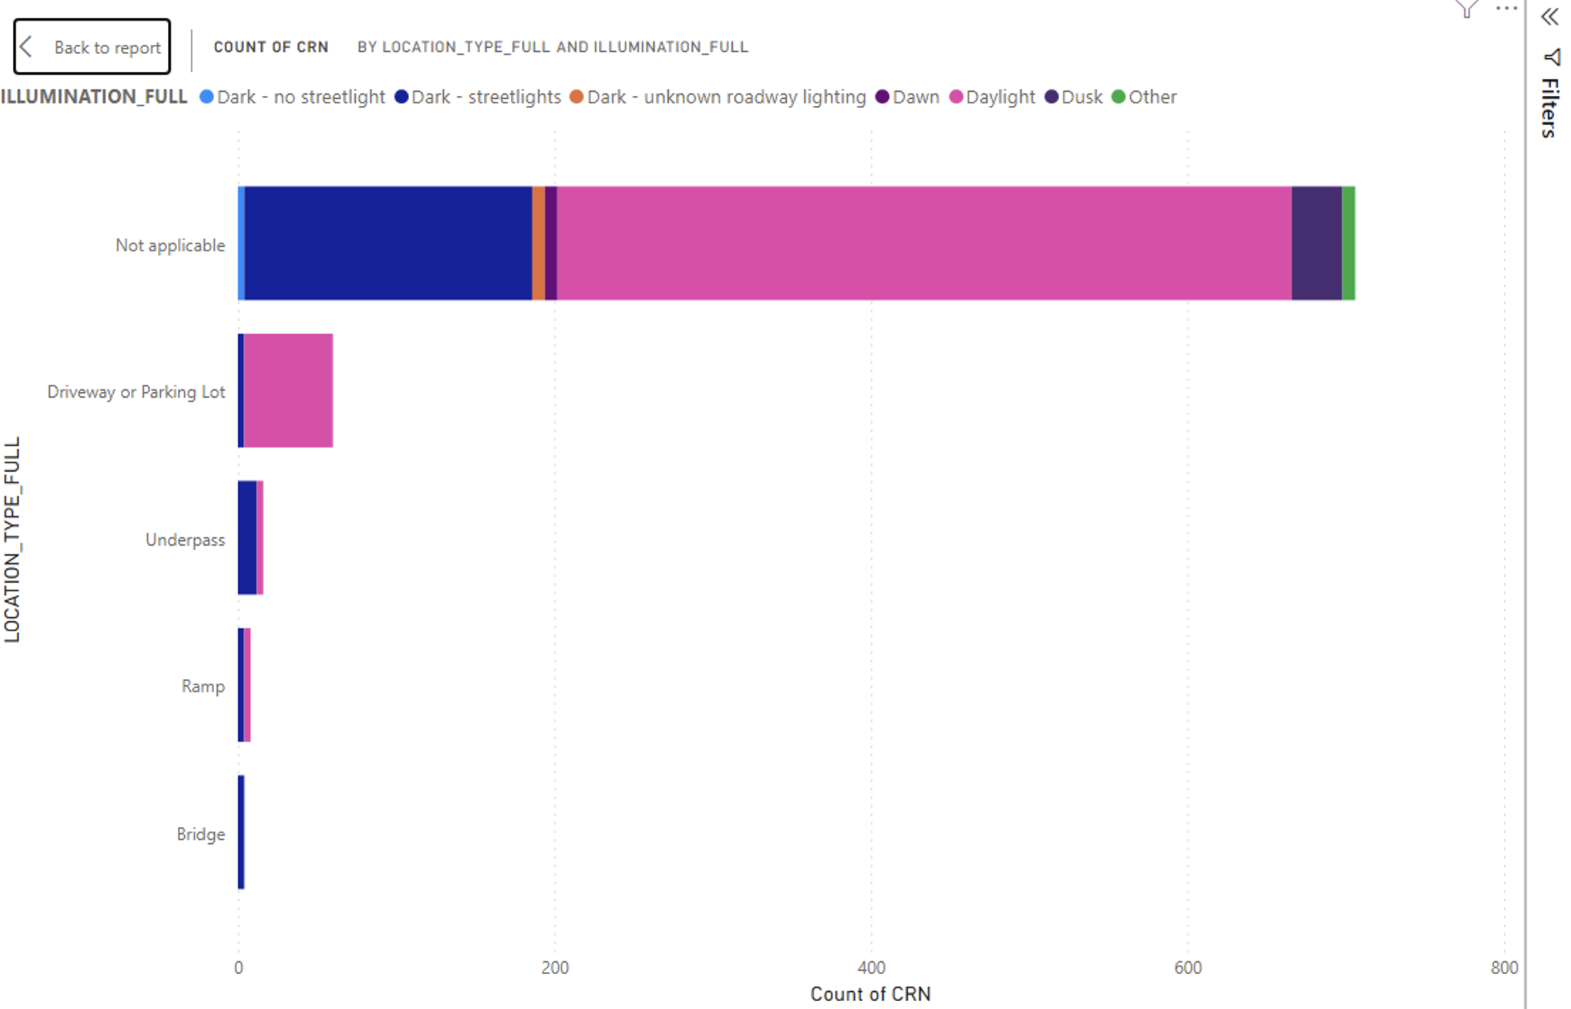

Slide 16
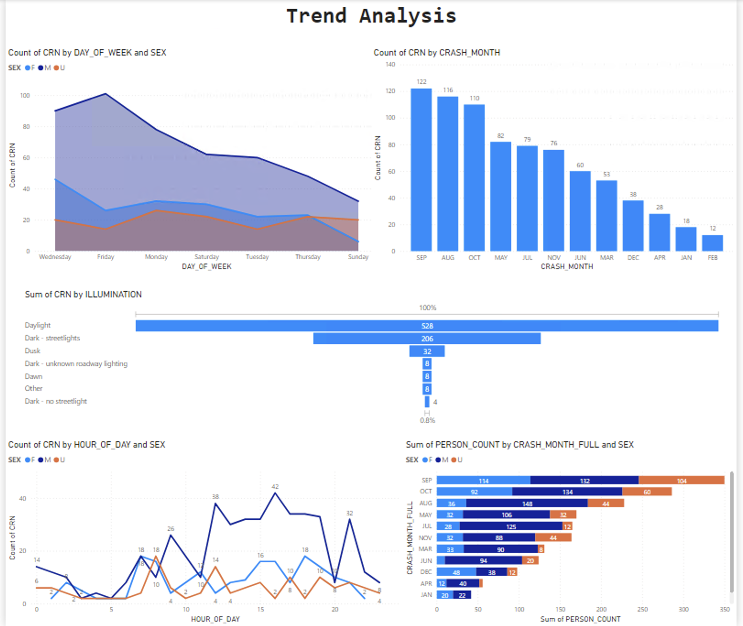

Slide 17
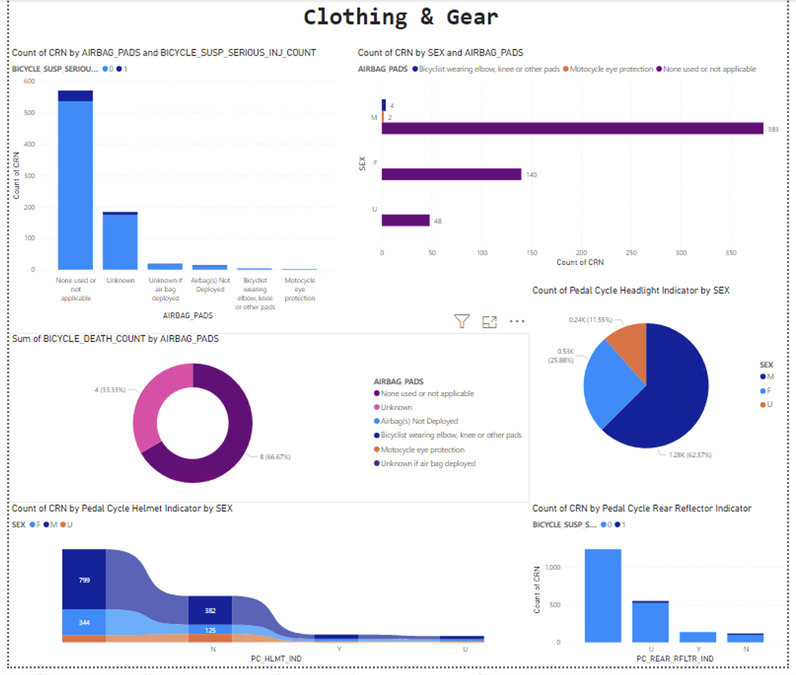

Slide 18
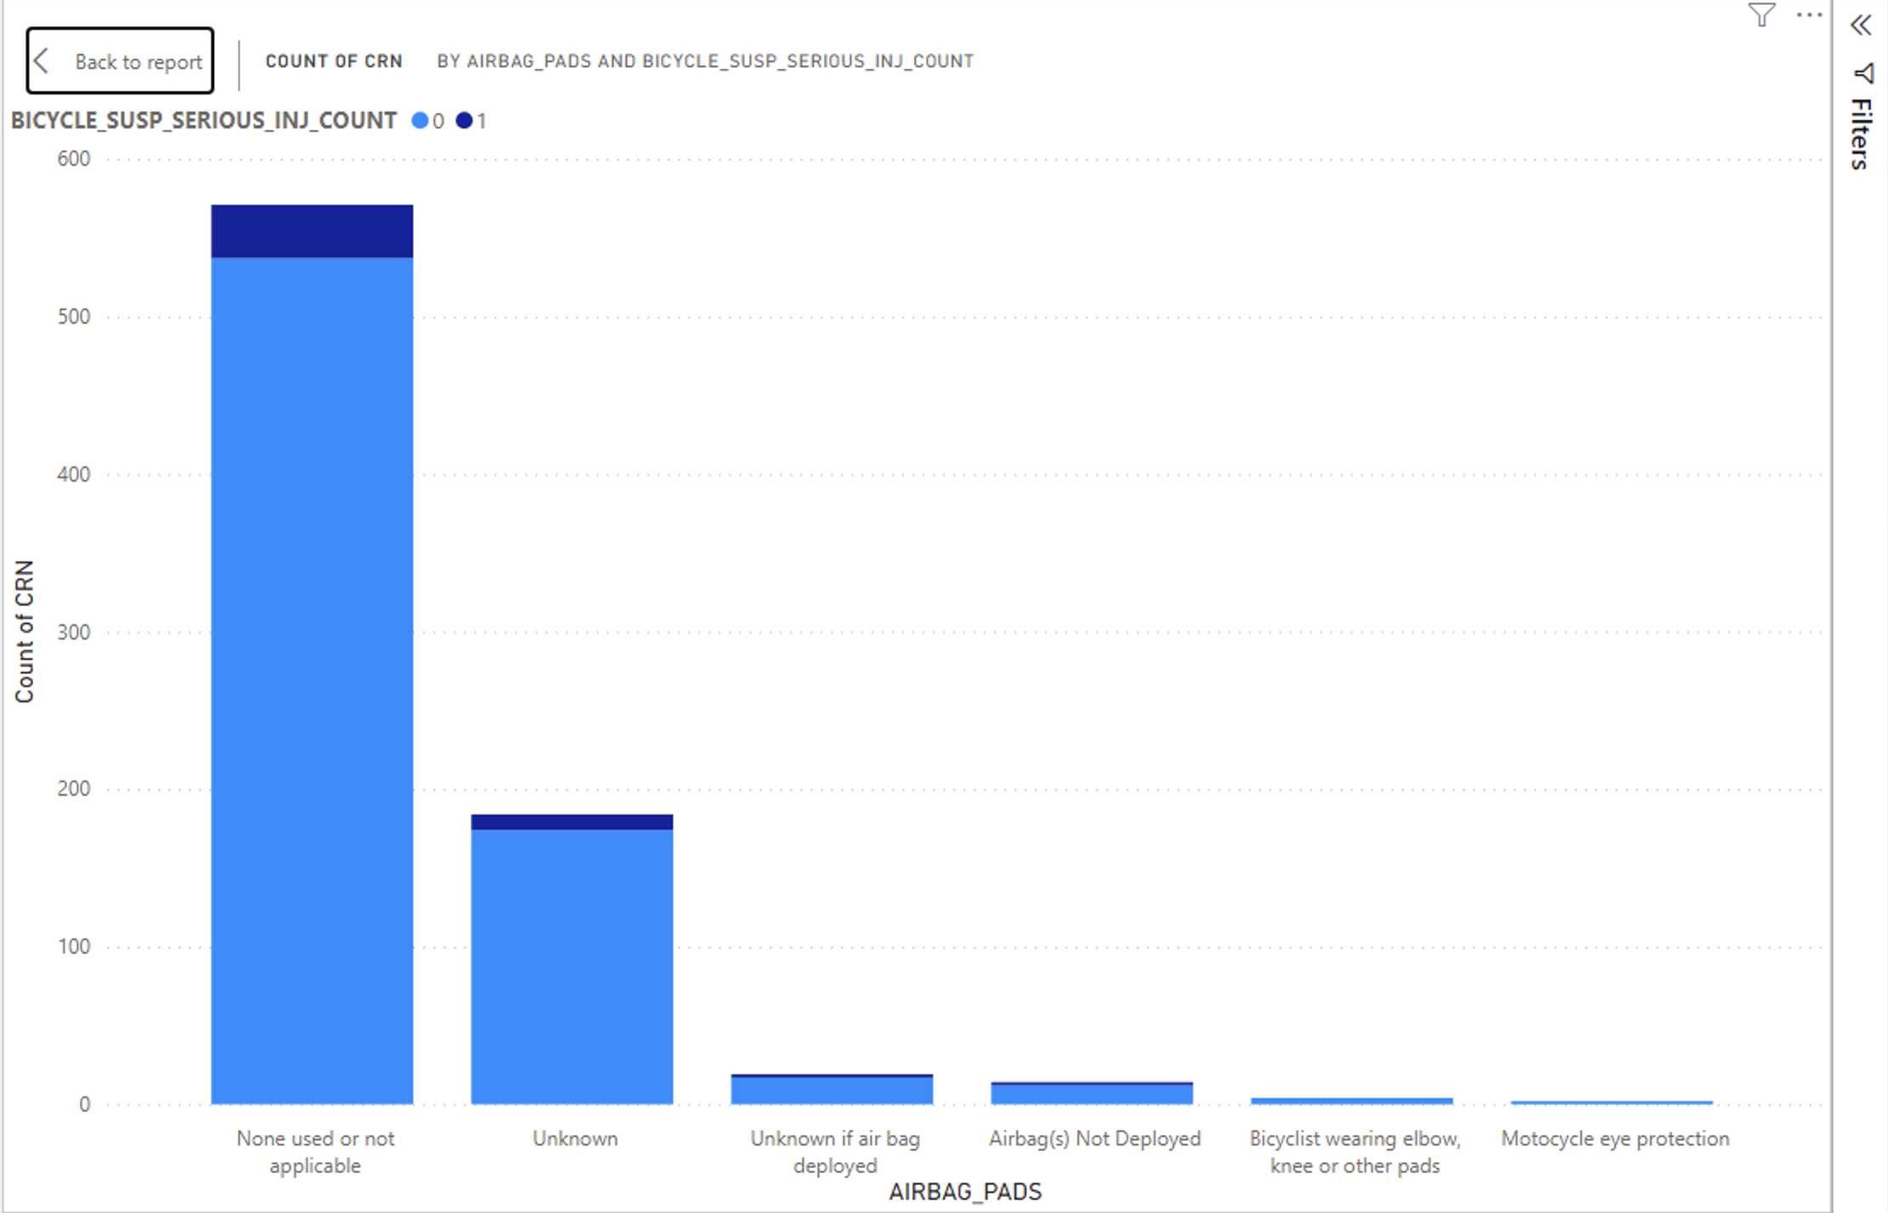

Slide 19
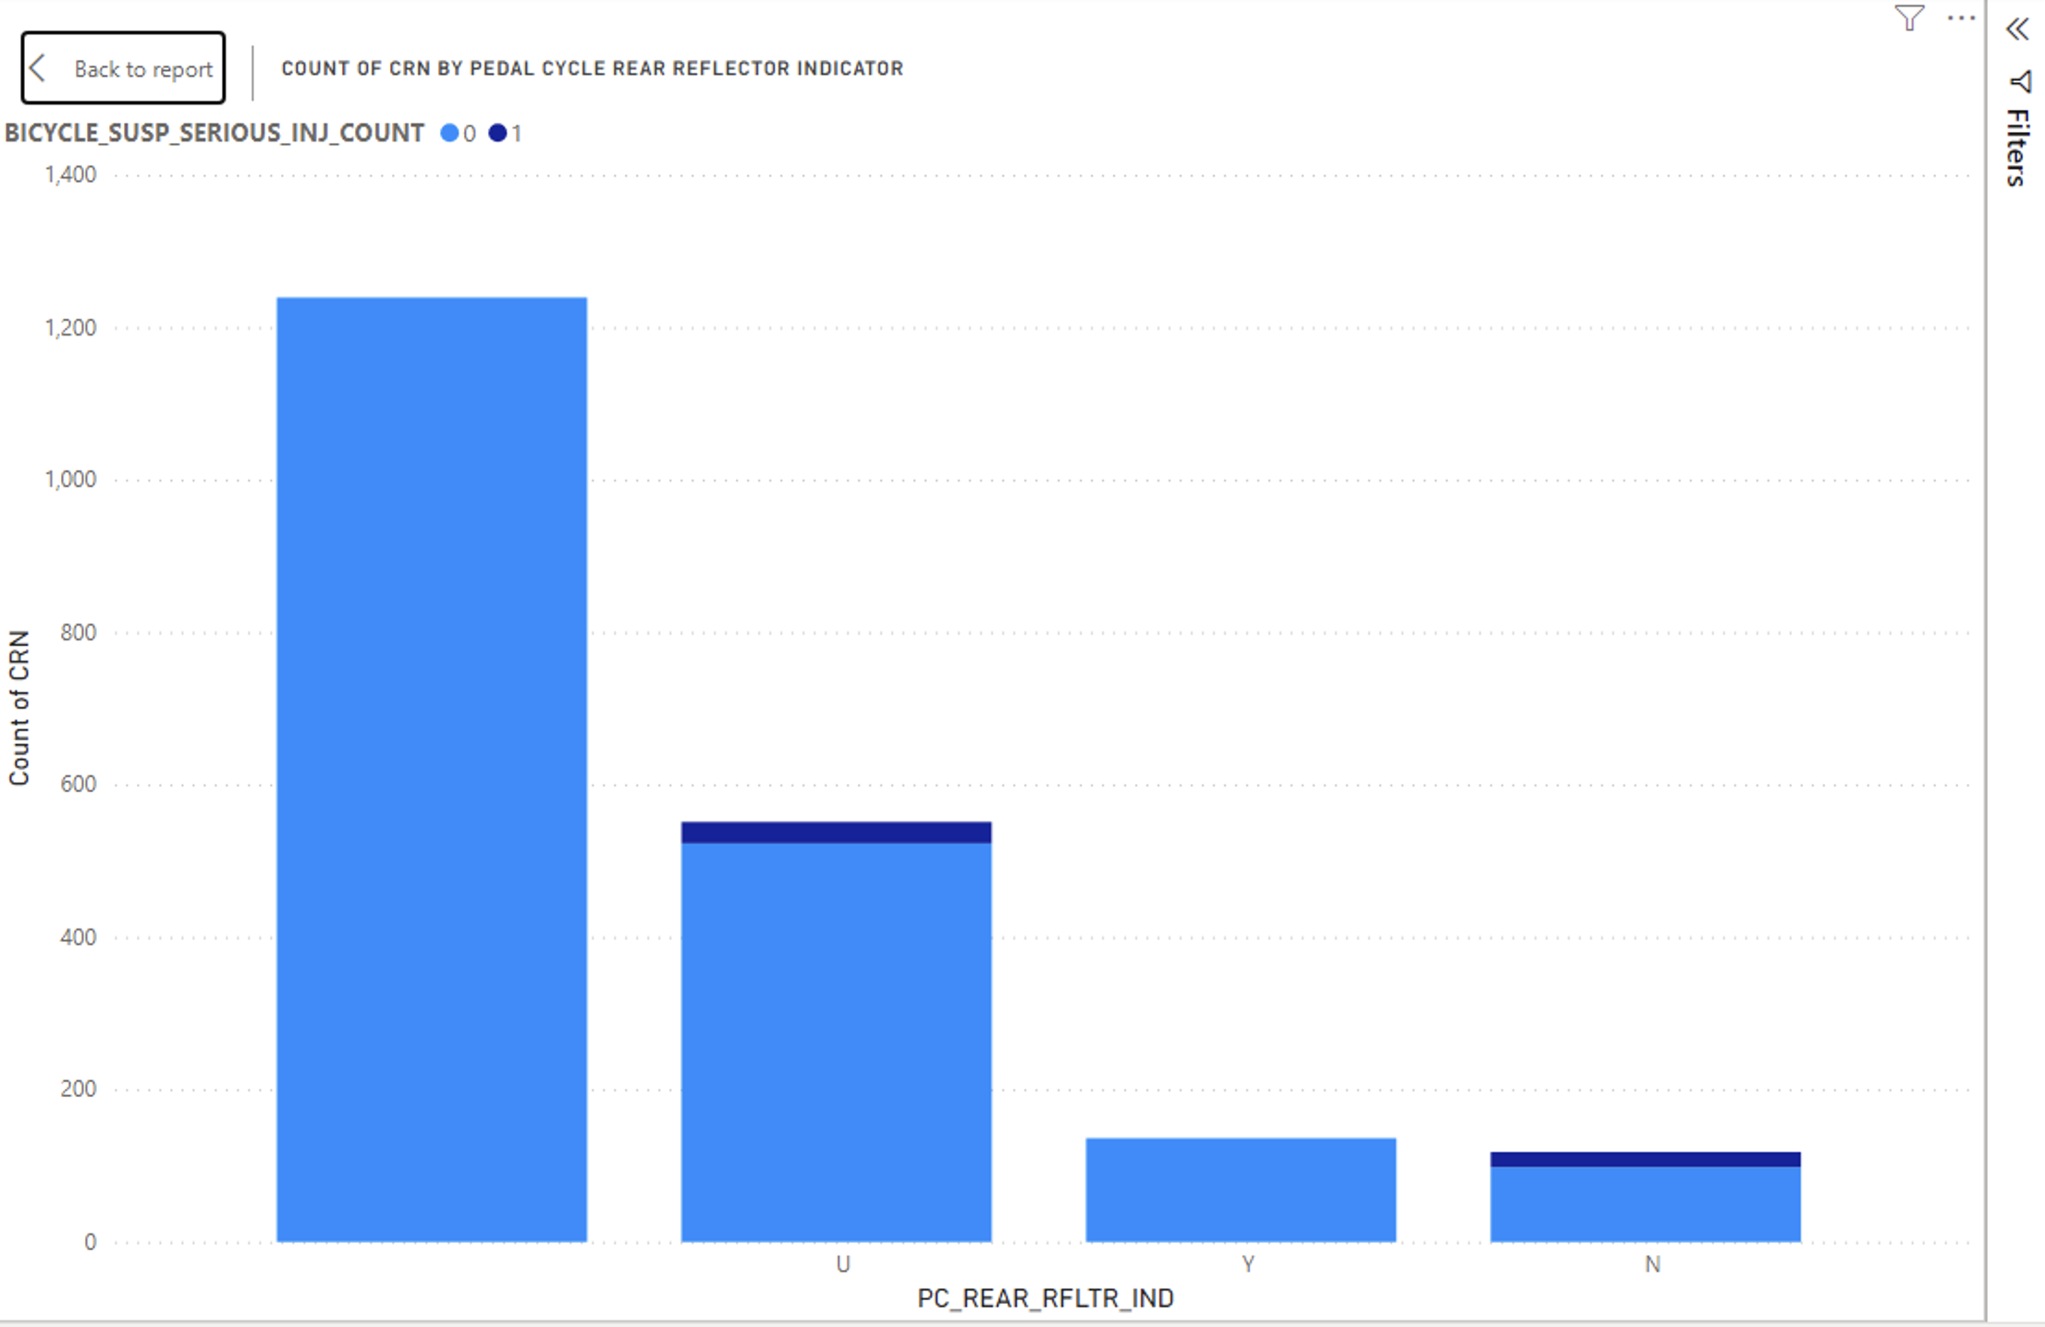

Slide 20
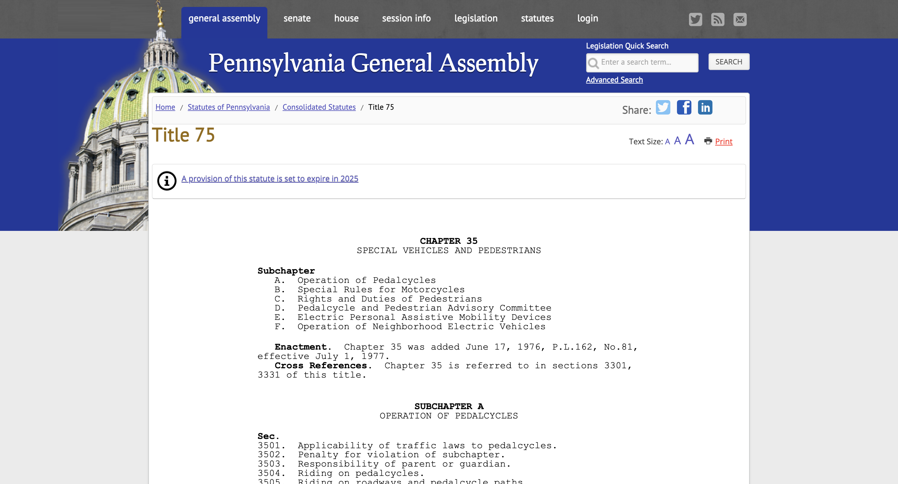
Bike Laws
Chapter 35 of the Pennsylvania Vehicle Code (Title 75)
Link

Slide 21
Pennsylvania Bike Law FAQs
What traffic laws apply to cyclists in Pennsylvania?
In Pennsylvania, bicycles are legally recognized as vehicles, entailing equivalent rights and responsibilities as motor vehicles. This includes adherence to all traffic laws, signs, and signals, such as stopping at stop signs and traffic lights.
Do I have to wear a helmet?
There is no statewide mandatory helmet law for cyclists. However, children under 12 must wear a helmet (whether they are the cyclist or the passenger on the bike).
Are there specific lighting requirements for bicycles in Pennsylvania?
In Pennsylvania, bicycles must have a front white light visible from 500 feet, a rear red reflector visible from the same distance, and effective brakes. Some areas also require bells and other safety devices.
Can I ride my bike across a crosswalk?
Cyclist must dismount and walk their bikes across crosswalks because, like cars, bicycles are not entitled to priority over other vehicles.
Can I access the freeway to reach my destination on my bike?
Bicycles can be ridden on Pennsylvania freeways with permission from the Pennsylvania Department of Transportation, typically granted for events such as bike races.

Slide 22

Bike Insurance Coverage & Compensation
Car insurance policies typically provide insurance coverage for bicycle injuries.
Insurance for bicycle accidents caused by bad road conditions or lighting issues should be filed with the city or municipality.

Slide 23
Recommendations for Safer Cycling
Prioritize safety and awareness on roadways.
1
Familiarize yourself with bike laws.
2
Stay visible and predictable, and exercise caution on roadways.
3
Go ahead and file a bike accident claim!
4

Slide 24

Get an Attorney! Link:

Slide 25

Questions?

Slide 26

Thank you!
Paper, Power BI Report, and Literature references are available upon request.

